Slide 1
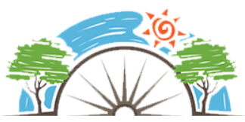
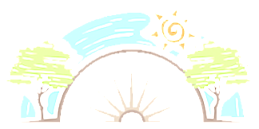
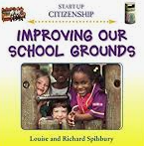
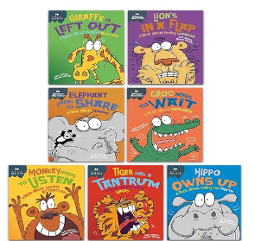

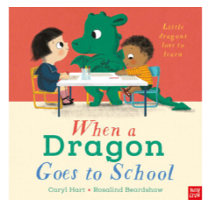
Year 1
Living in the wider world
PD
Sticky Knowledge
I know the importance of our school rules.
I can recall some of our school rules and know what happens when children don’t follow the rules
I know ways to show respect to wards others (listen to others, don’t yell, don’t say unkind things, be polite).
I know that a community is a group you belong to.
I can say groups I am part of and why they are special (school, village, clubs, and friends).
I know what recycling is.
I can suggest things we can all do in school to look after our classroom, playground and school grounds.
Key Questions
What are rules and why do we have them?
How can we show respect?
What groups/communities are we all part of?
What is recycling?
How can we help to look after school and our homes?
Key Vocabulary
Classroom rules, rights, responsibilities, needs, groups, communities, needs, environment, recycling

