Slide 1
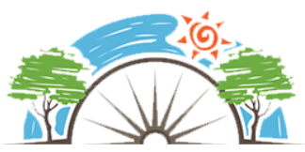
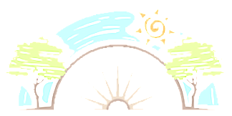
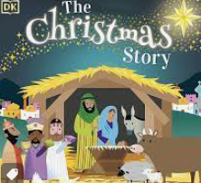
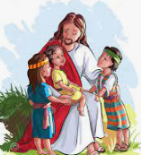
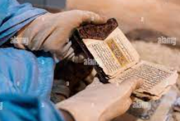
Year 1
Why are these words special?
Christianity and Islam
RE
Holy Books
We treat all books with respect.
The Bible and Qur’an are Holy books and are very special.
Holy books teach people lessons.
The stories in holy books often have a moral.
Key Vocabulary
Respect | A positive way of treating or thinking of someone
Bible | Christian holy book
Jesus | The son of god.
Qur’an | Muslim holy book
Prophet Muhammad | Creator of the Muslim faith
Holy Book | Special book liked to a religion
Muslim | People who follow the Islamic religion
Christian | Believe in Jesus
Christianity
Christianity is the main religion worshiped in the UK and the world.
Christians believe in Gid and Jesus his son.
The Bible is Christians holy book.
Be able to retell the Christmas story
Sticky Knowledge
Know that every religion has a place of worship.
Name the places of worship for Christianity and Islam (church and mosque).
Know about the importance of Mecca to Muslims.
Identify places that are special to them and why.
Identify religious symbols for Christianity and Islam (the cross and crescent and star).
Islam
Islam is the second biggest religion in the world.
Muslims believe in one god called Allah and the prophet Muhmmad is his messenger.
The Qur’an is Muslims holy book.
The Qur’an should be kept as high as possible, read from the back and only touched with gloves on.
Muslim children learn the Qur’an off by heart.

