Slide 1
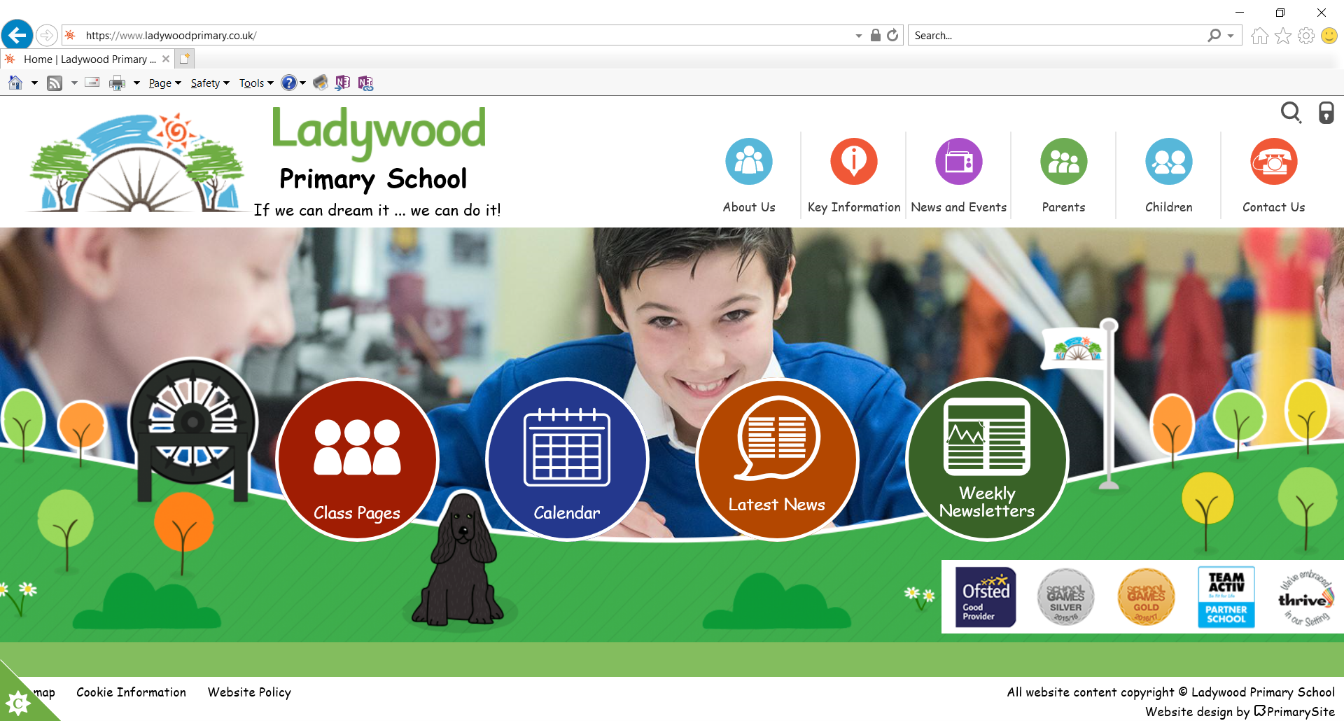
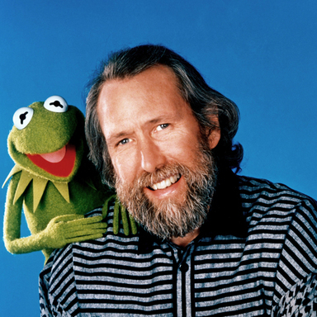
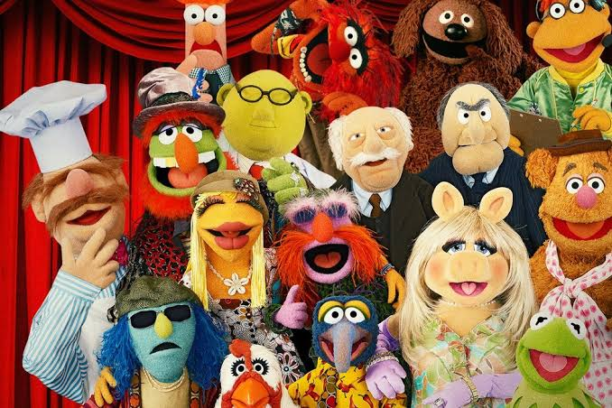
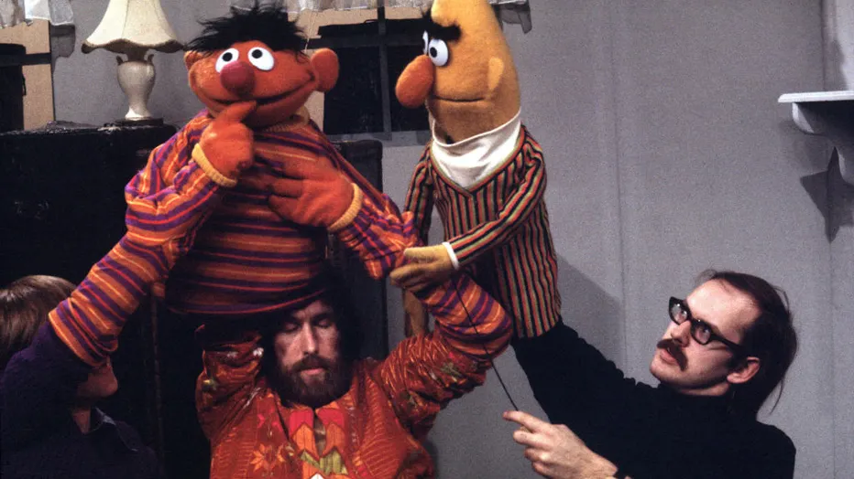
Year 1
Inventors and Inventions
DT
Jim Henson
Jim Henson was born in America in 1936
He was the creator of the Muppets.
The Muppets are a group of puppet characters which had their own TV series and several films
Jim Henson then went on to help develop the Muppet characters in Sesame Street

