Slide 1
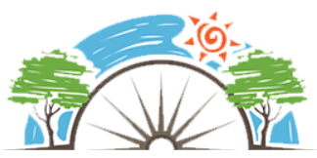
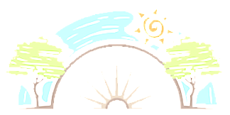
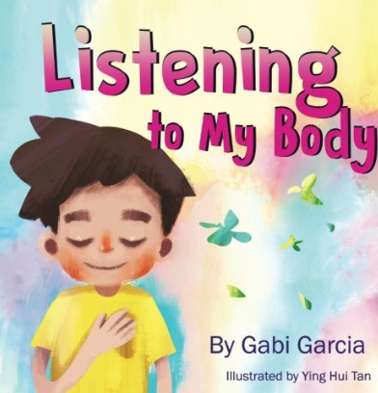

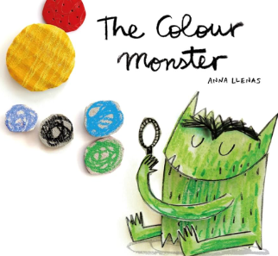






Year 1
Relationships
PD
Sticky Knowledge
I Can say how it feels when we feel happy, sad, scared and angry how that feels in our bodies.
I can say how we can be kind to others at school and at home.
I know the difference between a secret and a surprise.
I can participate in discussions with peers listening and taking turns to give opinions.
I know families include different people but all families care for each other.
I can play cooperatively.
I know no one has the right to hurt them and no one has the right to touch their private parts.
I know who I can talk to if I am upset or worried.
Key Questions
How can we show/ tell people how we are feeling?
When have we been kind to someone and how did it make them/us feel? What is the difference between a secret and a surprise? Why is it important to listen to the ideas and thoughts of others? Who are your special people? Who can you talk to if your are worried?
Key Vocabulary
listening, communicating, empathy, kind, secrets, surprises, share, discussion, opinion, turn taking, private parts, trusted adult, cooperatively.

