Slide 1
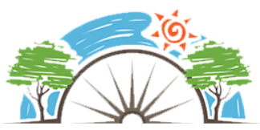
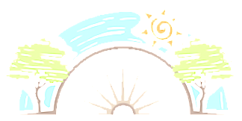
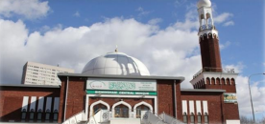
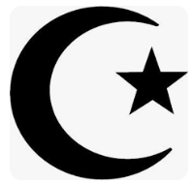
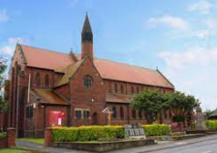
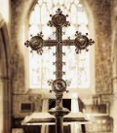
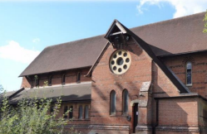
Year 1
Why are some places special?
Christianity and Islam
RE
Mosques
Mosques are special places for Muslims.
They are used by Muslims to worship and pray to Allah (God).
Men and women pray in different prayer halls.
Muslims take off their shoes and wash themselves before they pray.
Most Muslims cover their heads before entering the mosque.
There are no seats inside as Muslims worship and pray on the floor.
Inside a mosque, you might find: a dome, minaret, prayer hall, washing area, minbar and mihrab.
Patterns are used to decorate mosques
Mecca is the Holy city for the Islamic faith.
Key Vocabulary
Islam | One of the world major faiths.
Mecca | Holy city in the Islamic faith.
Important | Having great value
Christianity | Religion based on the teachings and Jesus.
Mosque | Place of prayer for Muslims.
Cross | Symbol of Christianity
Crescent | Islamic symbol of faith
Star | Islamic symbol of faith
Religious | Follow a faith
Belonging | Feeling comfortable
Relative | Someone in your family
Churches
A Church is a special place for Christians to feel close to Jesus and God.
• Christians worship and pray in Churches. They show that God is important to them by singing His praises and thanking him for all he does and all he has made.
• Inside a church, you might find: an altar, lectern, pulpit, pews, a font, stained glass windows showing Bible stories, an organ or piano, a cross and statues of religious figures.
Sticky Knowledge
Know that every religion has a place of worship.
Name the places of worship for Christianity and Islam (church and mosque).
Know about the importance of Mecca to Muslims.
Identify places that are special to them and why.
Identify religious symbols for Christianity and Islam (the cross and crescent and star).

