Slide 1
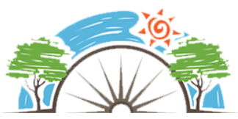
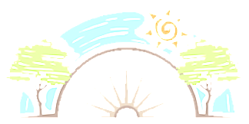



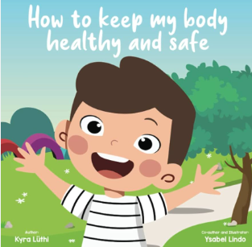





Year 1
Health and Wellbeing
PD
Sticky Knowledge
I know how you can help people around you and our responsibilities.
I can suggest ways of taking care of yourself on a daily basis.
I know which foods should be eaten in moderation and why.
I know getting enough sleep every day helps our brains work better.
I understand the phrase practice makes perfect.
I know change can sometimes feel scary.
In understand why we need to wash our hands.
I know how to cross a road safely
I know to say ‘no’ if they don’t feel comfortable with a touch.
I understand that people need to get the correct balance of time spent on screens.
Key Questions
Why do we need to get lots of sleep? How many times a day should you brush your teeth? What am I good at? How do I know? What can we do to help stop germs and diseases spreading? Can you describe how to cross a road safely? Should you trust strangers? If something is happening that we do not like, what can we say or do? Is it health to watch TV and play on devises all day long?
Key Vocabulary
Health, wellbeing, healthy eating, physical activity, sleep, dentist, likes, dislikes, choices, achievements, goals, strengths, target setting, change, loss, hygiene, clean, germs, stranger danger, screen time.

