Slide 1
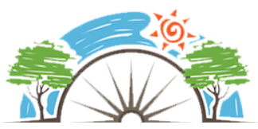
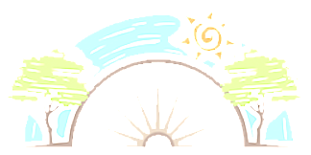


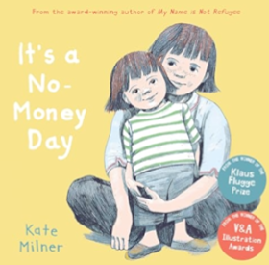



Year 2
Living in the wider world
PD
Sticky Knowledge
I know where money comes from, what it is used for and how to keep it safe.
I know the difference between ‘wants’ and ‘needs’.
I Know the importance and respecting difference
I know people that can help us in an emergency (trusted adults, police, doctors, paramedics, firefighters).
I can demonstrate how to get help in an emergency (dial 999) and what to say.
I understand the risks of talking to people you don’t know very well in the community.
I recognise kind and thoughtful behaviours.
Key Questions
What helps us choose how to spend money?
What does it mean if we say something is ‘unique’?
What communities are you part of?
Should we talk to everyone in our community?
Can you think of examples of being thoughtful and kind?
Key Vocabulary
Money, spending, saving, unique, special, people, similarities, community, special people, help, emergencies, thoughtful.

