Slide 1
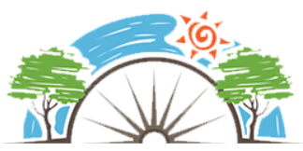
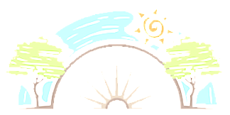
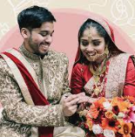
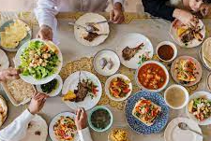
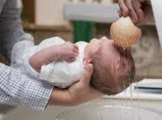
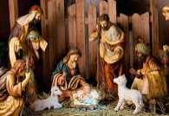
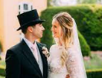
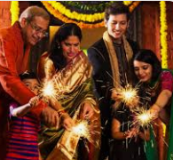
Year 2
Why are some times special?
Christianity, Islam & Hinduism
RE
Christian Celebrations
Christmas is one of the most important Christian celebration and celebrates the birth of Jesus. Christmas different in Christian homes.
Easter is a Christian festival that celebrates the resurrection of Jesus.
Babies are baptized to welcome them to the church family.
Christians get married in a church. Women often wear a white dress. The couple say vows and promises in the house of god.
Often Weddings and baptisms are celebrated often with a party with friends and family.
Islamic Celebrations
Ed al Fitr is an Islamic that follows the fasting of Ramadan.
In the Islamic faith, Muslims welcome babies in a ceremony called the Aqiqah (pronounced Ak-kee-ka) which is usually held on the seventh day after the baby is born. This is when the baby is introduced to family and friends.
Nikah, a muslim marriage ceremony is short. There are three main parts.
Key Vocabulary
Festival | A ceremony or celebration that repeats, often once a year, and involves special activities
Eid | Islamic festival
Birth | When a baby is born.
Celebrate | To make special with gifts, parties, or activities.
Wedding | Ceremony when two people marry
Christening & Baptism | The ceremony that means your are committed to living life as a Christian.
Diwali | The most popular celebration in India.
Sticky Knowledge
Know what traditions are followed by Christians at Christmas, Easter, christenings and weddings.
Know what traditions are follows by Muslims during Eid, when a baby is born and weddings.
Know Diwali is Guru Nanak’s Birthday.
Know how Diwali is celebrated by Sikhs.
Children identify how they celebrate special times.
Diwali
Known as the festival of lights.
People often think of Diwali as a Hindu festival, but it is also celebrated by Sikhs it isone of the most popular celebrations in India.
Diwali is celebrate over 5 days
It and marks the start of the Hindu New Year. The exact dates change each year and are determined by the position of the moon – but it usually falls between October and November
Celebrations include fireworks, food, gifts, colored sand, and special clay lamps.

