Slide 1
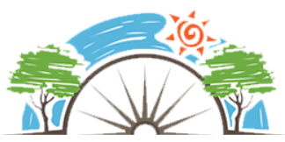
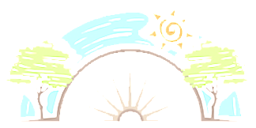

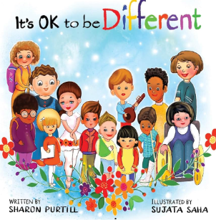

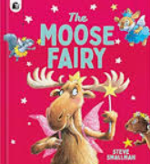

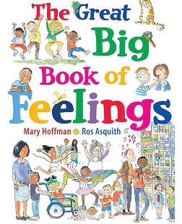


Year 2
Relationships
PD
Sticky Knowledge
I understand that we all have similarities but are not the same.
I understand that all people deserve respect, even if they are different to other people
I understand that families are highly varied; no family is the same
I know that families should love and care for each other.
I can describe the differences and similarities between being hurt physically and emotionally.
I know bullying is wrong and the different ways it can happen.
I know I should tell a trusted adult if they think someone is being bullied or think they are being bullied.
Key Questions
How are we the same and how are we different?
Are all families the same? Can feelings hurt as much as being physically hurt? Or, are there similar feelings? What are the differences between joking, hurtful teasing and bullying? Who should we tell if your being bullied?
Key Vocabulary
Difference, similarities, respect, varied, unique, families, love, bullying, trusted adult.

