Slide 1
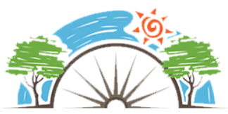
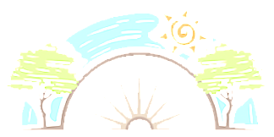







Year 2
Health and Wellbeing
PD
Sticky Knowledge
I can describe why they are more independent now from when they were younger.
I know the correct names for the main parts of the body of girls and boys.
I know my body is my own and no one has the right to hurt me or touch my private parts.
I know household products including medicines can be harmful if not used correctly.
I know I have the right to ‘be safe on the outside’ and ‘feel safe on the inside.
I know no matter what problems I have I can tell someone so I can get help.
I know things I can do to make me feel happy.
I know when I make mistakes its ok because I will learn from them.
Key Questions
What are the names of all the different parts of our bodies? How do we know whom to ask for help? Who can you talk to if you are feeling worried? Why is happiness important? What mistakes have you made in the past? What did you learn from them?
Key Vocabulary
Growing, changes, young to old, independence, girl/ boy body parts, private parts, penis, vagina, vulva, medicine, household products, safety risk, road safety, water safety, rail safety, fire safety, resilience, mistakes.

