Slide 1
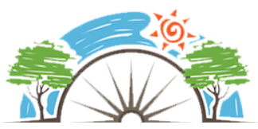
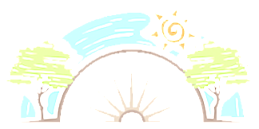


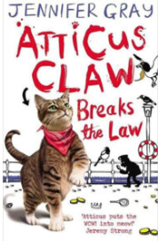

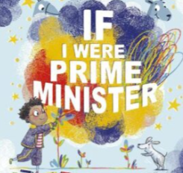
Year 3
Living in the wider world
PD
Sticky Knowledge
I know the ways in which rules and laws keep people safe and fair, take part in making and changing rules.
I know humans have basic needs (food water and shelter and to be safe happy and to have the opportunity to learn and develop).
I know all humans no matter where they are in the world deserve to have their basic need met, this is their right.
I know what anti-social behaviour is, how it can affect people and how to get help.
I know the importance of following rules at home and school - staying safe.
I know that been responsible is being sensible and making good choices.
Key Questions
Why do we have rules in school?
Why are human rights important?
What behaviours could be called anti-social?
Who should we talk to if we think someone has stolen something?
Key Vocabulary
Rules, laws, making and changing rules, human rights, children rights, anti-social behaviour, rights, duties, stealing, sensible, responsible, borrowing, stealing.

