Slide 1
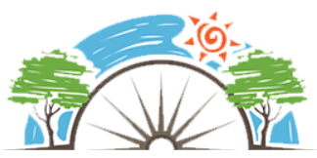
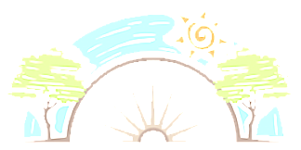
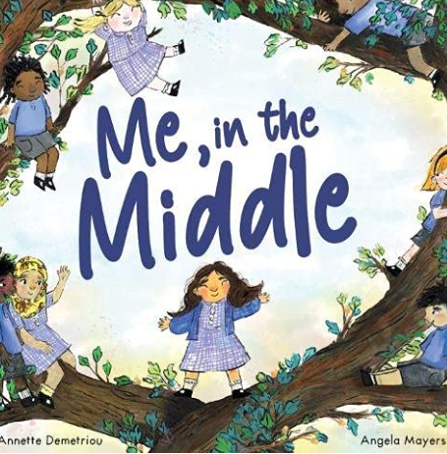
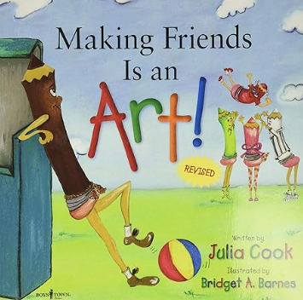
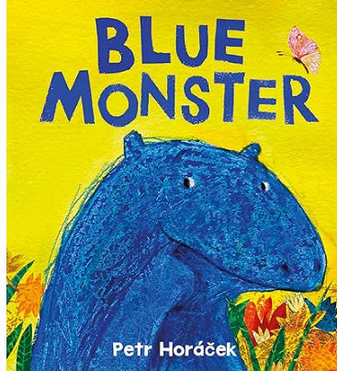



Year 3
Relationships
PD
Sticky Knowledge
I know how to resolve differences (agreeing and disagreeing).
I can recognise a wider range of feelings in others and responding to how others are feeling.
I know what makes a positive, healthy relationship including friendships and how to maintain them.
To know how actions affect ourselves and others.
To know how to listen and respond respectfully to a wide range of people and share points of view.
I can work collaboratively towards shared goals.
I appreciate that there are many differences between families and all families are unique
I know when they should or should not agree to keeping a secret.
Key Questions
Do good friends always think the same about things? Why does talking and sharing feelings help? Are we only allowed one ‘Best Friend’? How can we make our views heard without falling out with others? Why is team work important? When is it OK/ not OK to keep a secret?
Key Vocabulary
Feelings, empathy, friendships, families, couples, positive relationships, actions, consequences, confidentiality, secrets, surprises, listening, viewpoints, opinions, respect, collaborate, compromise, shared goals.

