Slide 1
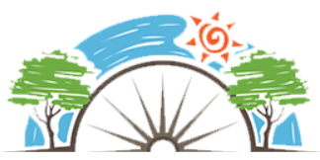
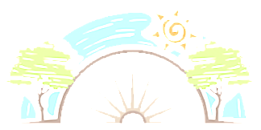






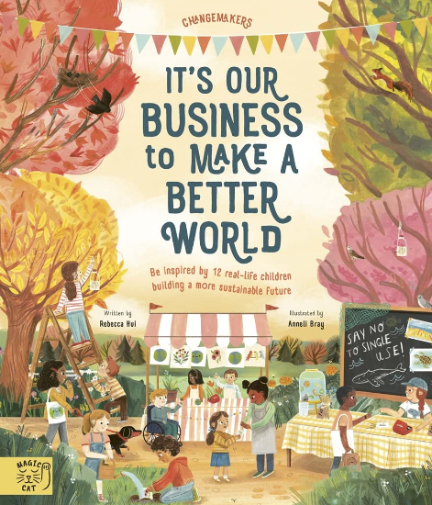
Year 4
Living in the wider world
PD
Sticky Knowledge
I appreciate that we should respect other people, regardless of their unique characteristics.
I know discrimination is when someone treats you differently.
I understand that we don’t have to be the same as everyone else to be friends.
I know some of the ways people can show respect for different cultures and identities.
I understand that not everyone has the same access to money and employment across the world.
Recognise some way in which we can spend money via technology.
I can explain why climate change is not good for the earth.
I know what is meant by enterprise and begin to develop enterprise skills.
Key Questions
What is discrimination? Can we be different and still be friends? What do people have to think about before we decide to spend or save? What does ‘in app purchases’ mean? What can we do at home and at school to help? (Reduce our carbon footprint).
Key Vocabulary
People, difference, diversity, identify, places, values, customs, money, spending, saving, budgeting, in app purchases, sustainability, environment, global warming, enterprise.

