Slide 1
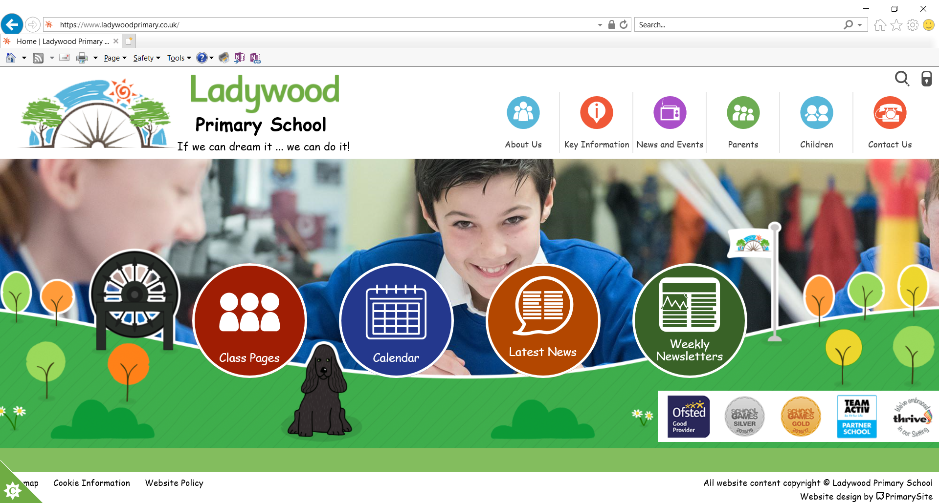
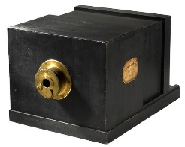
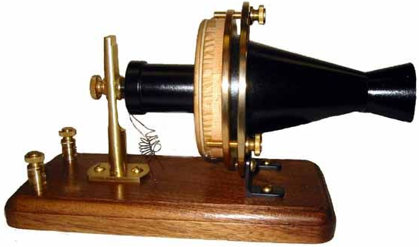
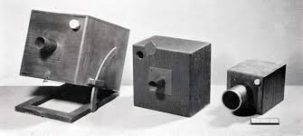
Year 4
Inventors and Inventions
DT
Photography
Telephone
Louis Daguerre
Louis Daguerre was born in France in 1787.
He is known as one of the fathers of photography inventing the daguerreotype which created a one-of-a-kind image on a highly polished, silver-plated sheet of copper.
This type of photography became very popular as it was capable of capturing a "truthful likeness.“
However, the Daguerreotype did not create negatives so each picture was therefore unique, the only way to get a copy was to re-photograph the image.
William Henry Fox-Talbot
William Henry Fox-Talbot was born in England in 1800.
In 1833, he visited Italy where he dreamed up a machine that would sketch the beautiful environment for him.
William was interested in studying light and chemicals so he used this knowledge to go on to invent ‘photogenic drawings’, which used light-sensitive paper to record images.
In 1840, he modified and improved this process and called it the ‘calotype’ (or Talbotype). The calotype used photographic negatives, from which multiple prints could be made, and had a much shorter exposure time than previous methods.
Alexander Graham Bell
Alexander Graham Bell was born in Scotland in 1847.
His family was known for teaching people how to speak English clearly (elocution). He was interested in sound as both his mother and wife were deaf.
In 1876, the telephone was invented
Bell’s first words with the working telephone were spoken to his assistant Watson and were “Mr Watson, come here. I want to see you.”

Slide 2
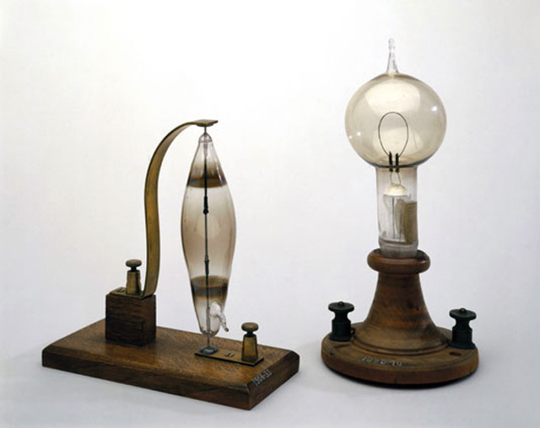
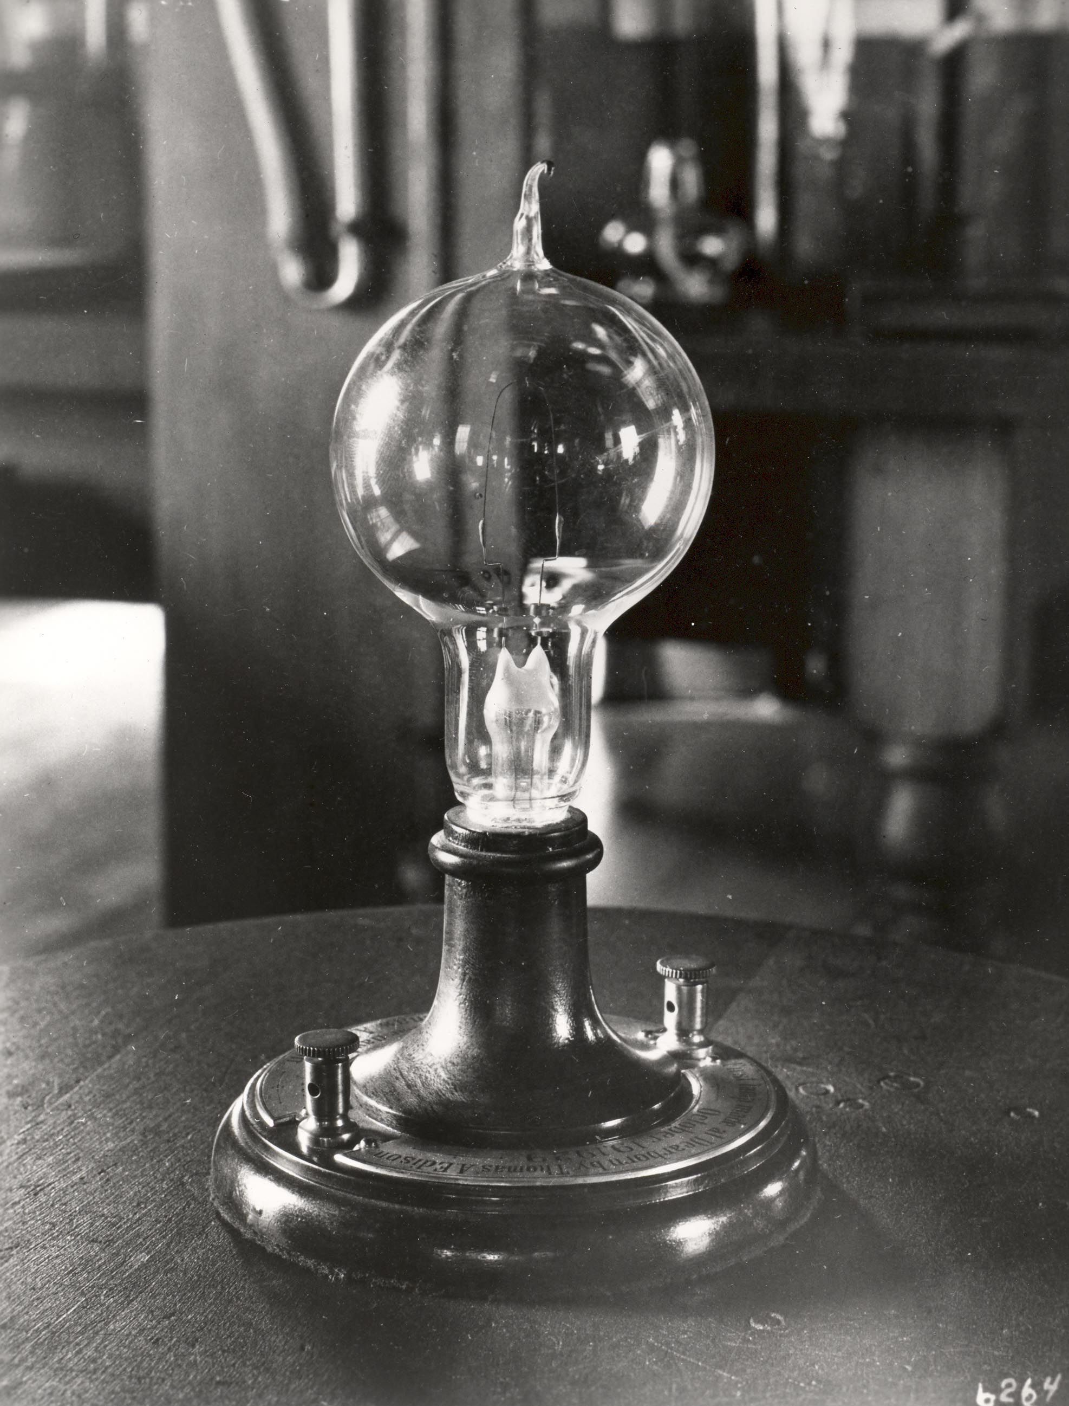
Year 4
Inventors and Inventions
DT
Lightbulb
Humphry Davy
Humphry Davy was born in England in 1778.
In 1802, Humphry Davy made the first electric light. He invented an electric battery after many experiments with electricity. He connected wires to the battery and a piece of carbon. The carbon glowed and produced light. However the light did not last very long.
His invention was called the ‘Electric Arc Lamp’.
Thomas Edison
Thomas Edison was born in America in 1847.
He developed one of the first practical light bulbs
In 1879, Thomas discovered that a carbon filament glowed in an oxygen free bulb for up to 40 hours before burning up.
After more experimenting, Edison produced a bulb that could glow for more than 1500 hours.
Edison tried 4,7000 different materials to find the perfect filament, including hair from a beard.

Slide 3
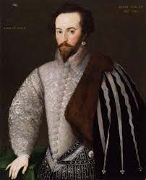
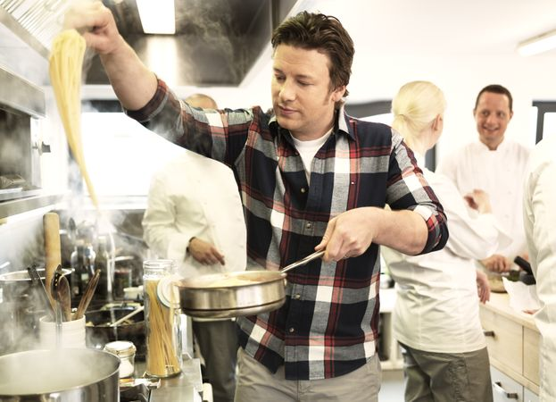
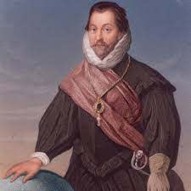
Year 4
Chefs and Innovations in food
DT
Explorers Food
Jamie Oliver
In Tudor times, lots of explorers brought new food from newly discovered places
Sir Walter Raleigh led many expeditions to America and introduced tobacco and the potato into England.
Jamie Oliver was born in England in 1975.
He is a famous chef who is known for his television shows, cookbooks and restaurants.
In 2005, Oliver started his 'school dinners' campaign to improve the quality of food fed to pupils in schools.
His campaign to improve the standard of Britain’s school meals eventually persuaded the British Government to spend £280m on school dinners.
Sir Francis Drake was the first Englishman to sail around the world. He brought back lots of different spices from the West Indies.

