Slide 1
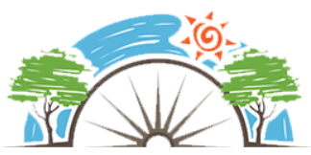
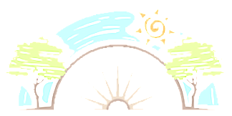






Year 4
Relationships
PD
Sticky Knowledge
I know the difference between acceptable and unacceptable physical contact.
I appreciate that friendships are not always perfect.
I know there are differences and similarities between people but understand everyone is equal.
I can recognise bullying, how to respond and ask for help.
I can recognise peer pressure.
I can explain what is mean by stereotyping.
I know what to do if I am worried about something that has happened at home and how this can affect them at school.
Key Questions
What should we someone do if someone is touching us in ways we don’t like? Should you always do what your friends want? Do we have things in common with those we think are different to us? What can we do if we witness bullying online or in person? Not all friendships are healthy, but how do you know? Is there such a thing as “man’s” or “woman’s” job? Who can you talk if you are worried about something at home?
Key Vocabulary
Equal, inclusive, disputes, conflict, negotiation, compromise, identify, similarities, differences, equality, bully, stereotypes, acceptable and unacceptable touch.

