Slide 1
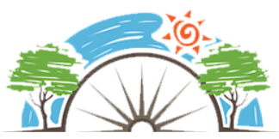
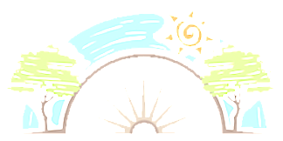






Year 5
Living in the wider world
PD
Sticky Knowledge
I can explain steps that I can take, with help from others, to look after my own health and wellbeing.
I can give example of how rules and laws are made and enforced
I can explain what is meant by a democracy.
I know the effects of anti-social behaviour prosecution by the police, risk to life, hard to physical and mental health.
I know how to prevent anti-social- treat everyone with respect, be polite, choose not to join in anti-social behaviour and put rubbish in the bin.
I can describe the ways in which we can contribute to our home, school and community.
I can explain what consent means.
I can explain what a good citizen is.
Key Questions
What can we do to improve our own mental health?
Can you explain what is mean by democracy?
How can antic social behaviour affect how someone feels?
What are our community and environmental responsibilities?
What is consent?
What makes a someone a good citizen?
Key Vocabulary
Discussion, debate, topical issues, problems, events, rules, laws making and changing rules, anti-social behaviour, rights, duties, home, school environment, decisions, choices

