Slide 1
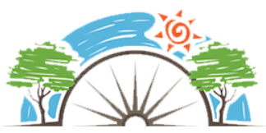
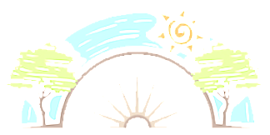
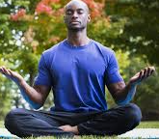
Year 5
Why are some words and places special.
Hinduism & Judaism
RE
Buddhism
The writings of the Buddha teach about finding happiness and freedom from suffering.
Know the story of ‘The Free Bird and Buddha’.
Lumbini (Siddhartha’s birthplace), Bodh Gaya (the place of his Enlightenment) , The Deer Park at Sarnath (where he first preached the Dhamma) and Kushinagara (where he passed away) are special places to Buddhists.
Buddhists make pilgrimages to special places.
Buddhists help within the community including donating to monastery and temple, making offerings of food and new robes, help with cleaning of building work.
Mediation is really important part of the Buddhism faith.
Buddhism does not have laws or commandments but its five ethical precepts are guidelines for how to live in a way that avoids harming others or oneself.
Buddhist charitable organisations are working to ensure the world is a better place - Karuna Trust and the Buddhist Hospice Trust).
Key Vocabulary
Menorah | A candelabra with seven or nine lights that is used in Jewish worship.
Kippah | A brimless cap, usually made of cloth, traditionally worn by Jewish males.
Yad | Jewish ritual pointer, popularly known as a Torah pointer, used by the reader to follow the text during the Torah reading.
Tallit | A Fringed garment worn as a prayer shawl by religious Jews and Samaritans.
Yad | A yad is a Jewish ritual pointer used by the reader to follow the text during the Torah reading.
Tallit | A fringed garment worn as a prayer shawl.
Torah | The compilation of the first five books of the Hebrew Bible.
Judaism
Read Abraham’s story and The story of Adam and Eve.
The synagogue is an important center for Jewish communities where meetings take place and social gatherings happen.
Shabbat: (Saturday – the seventh day and day of rest)No work is to be done on Shabbat.
At age 13 a boy becomes a Bar Mitzvah (a son of the commandments) and at age 12 a girl becomes a Bat Mitzvah (a daughter of the commandments). Bar and Bat Mitzvah ceremonies are significant because they are seen as the time of coming of age, when a child becomes an adult.
Sticky Knowledge
To know that the writing of the Buddha teach about finding happiness and freedom from suffering,
To describe how stories from the Jewish scriptures can be used to explain some of life’s questions.
To understand the significance for many followers of the Buddha of the Four Sites.
To recognise the importance of the synagogue in Jewish life and use religious language to describe some rituals
To describe the impact of Jerusalem on Jewish people today to understand why Jerusalem is a special place to Jewish people.
Pilgrimage | A journey made to some sacred place.
Meditation | A practice that involves focusing or clearing your mind.
Charity | Generosity and helpfulness towards people who need it.

