Slide 1

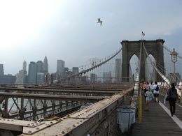
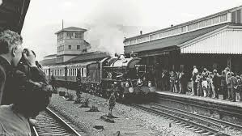
Year 5
Inventors and Inventions
DT
Bridges
Isambard Kingdom Brunel
Isambard Kingdom Brunel was born in England in 1806.
Brunel worked on the Thames tunnel with his dad, who was also an engineer. He almost drowned when the roof collapsed and flooded in 1827.
While Brunel was recovering, he entered and won a competition to design a bridge over the Avon river gorge in Clifton, Bristol – this later became the Clifton Suspension Bridge.
Brunel was the chief engineer of the Great Western Railway which connected London to the rest of the country. He also built many tunnels and bridges that are still used today.
John A Roebling
John Roebling was born in Germany in 1806.
In 1831, he travelled to America in search of more opportunities.
He designed and built wire rope suspension bridges.
In around 1839, Roebling decided to manufacture a strong but flexible wire rope to use
Roebling designed the Brooklyn Bridge in America which was built from 1869 to 1883. However Roebling did not see the completed bridge as he died before it was finished.

Slide 2
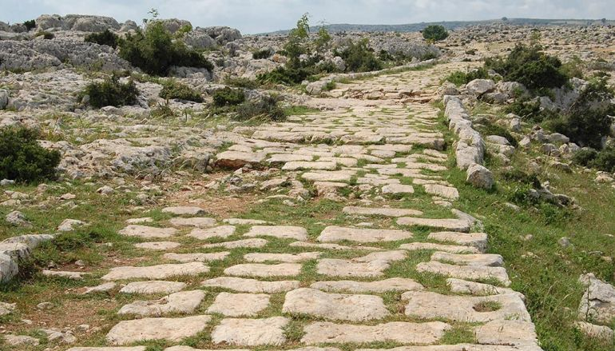
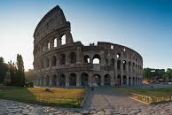
Year 5
Inventors and Inventions
DT
Roman Inventors and Inventions
Roads
The Romans built the first roads in Britain.
The roads were so well built that you can still see some of them today, 2000 years after they were first built!
They built roads as straight as possible, in order to travel as quickly as they could. Winding roads took longer to get to the place you wanted to go and bandits and robbers could be hiding around bends.
The Fosse Way was one of the first great Roman roads in Britain. It ran from Exeter to Lincoln, passing through Bath, Gloucester and Leicester.
Concrete
Many ancient Roman structures like the Pantheon, the Colosseum and the Roman Forum are still standing today thanks to the development of Roman cement and concrete.
The Romans first began building with concrete over 2,100 years ago and used it throughout in everything from aqueducts and buildings to bridges and monuments.
Roman concrete was considerably weaker than modern concrete, but it has proved remarkably durable.

Slide 3
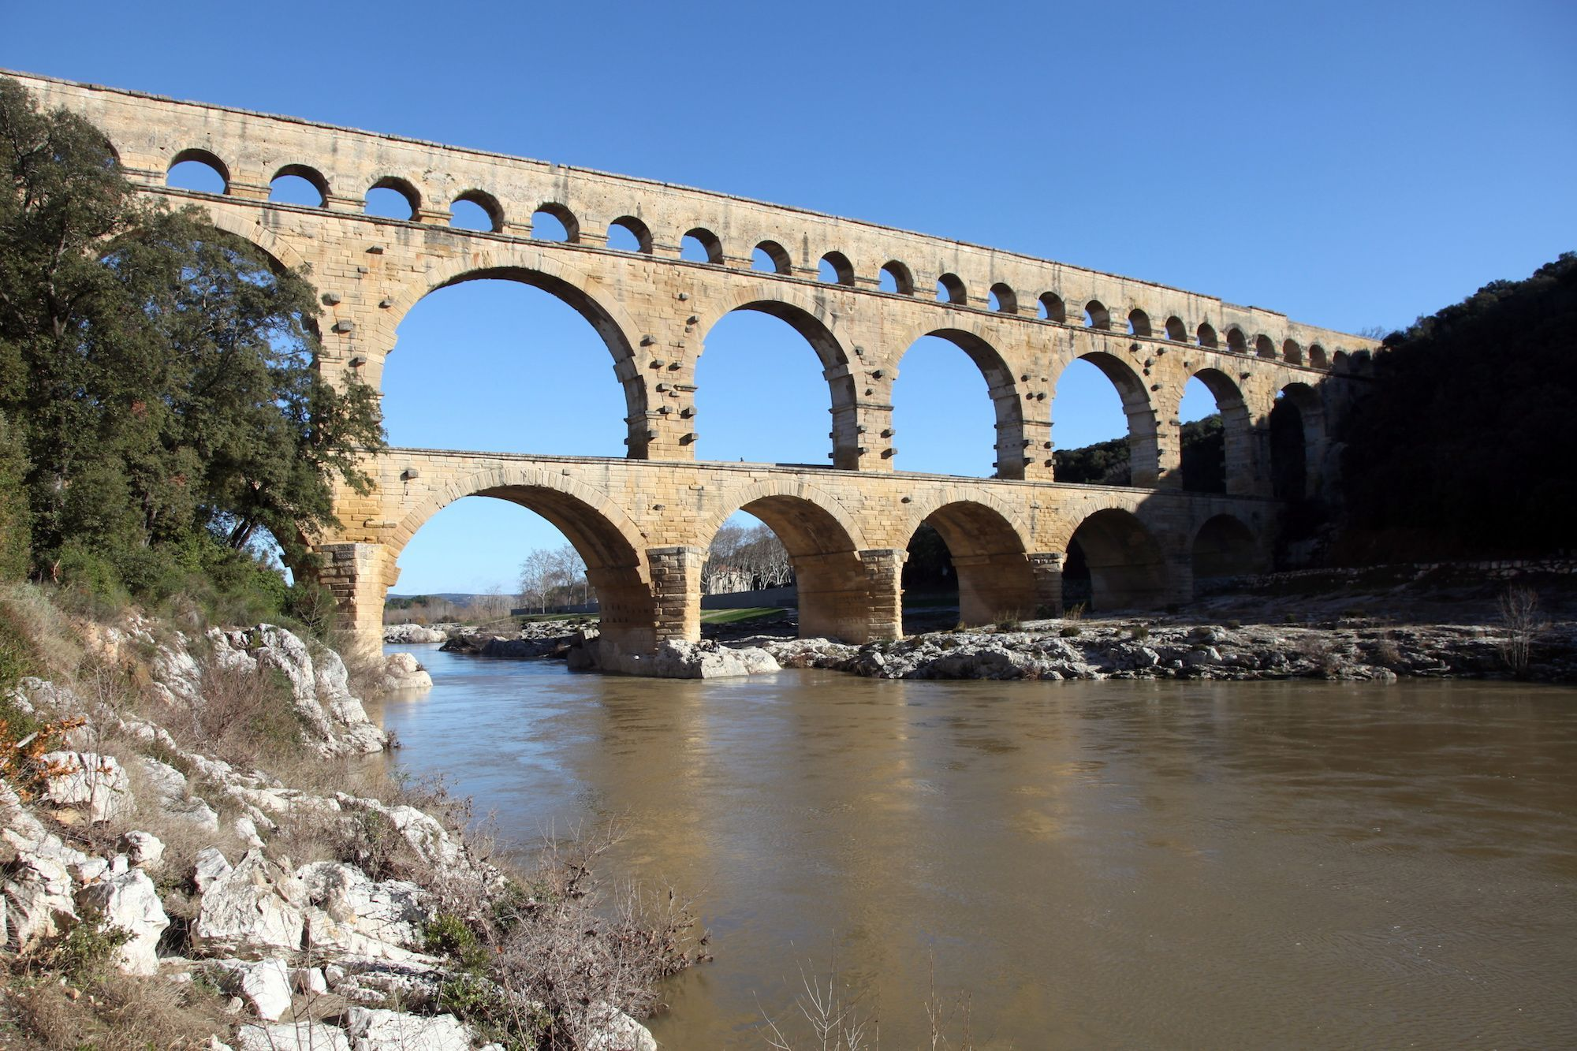
Year 5
Inventors and Inventions
DT
Roman Inventors and Inventions
Aqueducts
First developed around 312 B.C., aqueducts used gravity to transport water along stone, lead and concrete pipelines and into city centres.
Aqueducts meant that Roman cities no longer had to rely on nearby water supplies and helped in promoting public health and sanitation.
While the Romans did not invent the aqueduct they used their knowledge of civil engineering to perfect the process.
Arches
Arches have existed for roughly 4,000 years, but the Romans were the first to effectively use them in the construction of bridges, monuments and buildings.
The design of the arch allowed the weight of buildings to be evenly distributed along various supports, preventing massive Roman structures from crumbling under their own weight.
Roman engineers improved on arches by flattening their shape to create a segmental arch and repeating them at various intervals to build stronger supports.

