Slide 1
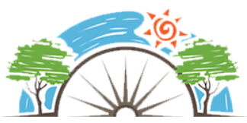
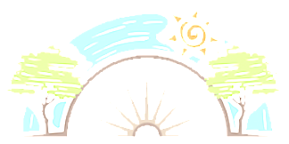
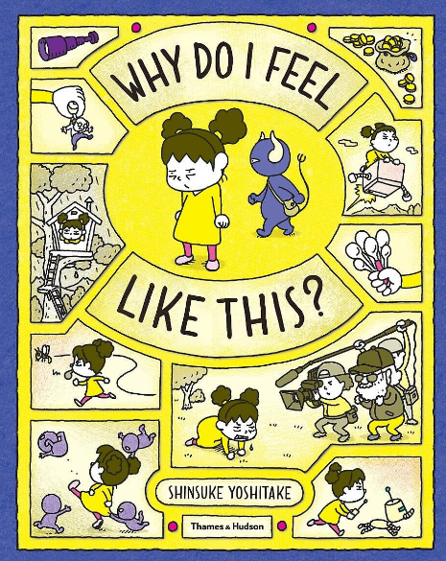

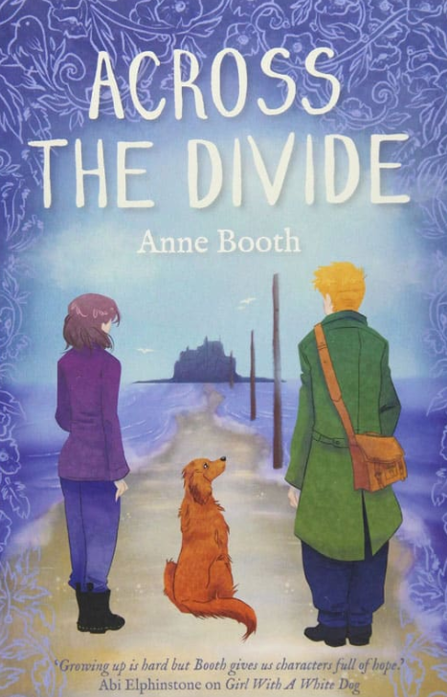



Year 5
Relationships
PD
Sticky Knowledge
I understand why it is better to demonstrate self - control and restraint in emotional situations, staying calm and making good choices, even when others are not.
I can suggest alternative strategies they can use to resolve differences.
I can suggest how to help see and respect others’ points of view (e.g. putting yourself in their shoes).
I can recognise when a relationship is unhealthy.
I can understand that friendship is not just about doing what someone says and that boundaries are healthy and an essential part of any relationship.
I can explain how someone’s actions might have consequences for themselves, family, friends, wider community.
I can explain the importance of ‘stopping’, ‘taking a step back’ and asking ‘What if…’
Key Questions
Why do we argue?
What strategies can people use to resolve differences?
Do we have to agree with others’ points of view? Not all friendships are healthy, but how do you know?
Key Vocabulary
Feelings, empathy, recognising others feelings, relationships, unhealthy, points of view, boundaries, actions, behaviour, consequences.

