Slide 1
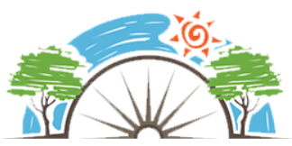
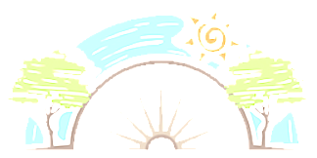




Year 6
Living in the wider world
PD
Sticky Knowledge
I appreciate a range of religious and ethnic identities of people living in the UK and we are all British.
I can consider what poverty is and how it can affect quality of life and opportunities.
I understand that finance plays an important part in people’s lives and the importance of being a critical customer.
I understand the terms ‘invest’ ‘loan’ ‘debt’ and the importance of looking after money.
I know to be critical of what I see in the media and consider information they choose to forward to others.
Key Questions
Do people all come from the same culture?
Is it a good thing or a bad thing that we are not all the same?
What is poverty?
Do we al have the same starting points in life? How can we be critical consumers and ensure we are getting value for money?
Is what the media show us always true?
How does media influence peoples views?
Key Vocabulary
Communities, difference, diversity, identity, UK, values, customs, money, spending, saving, budgeting, interest, loan, tax, debt, media, social media, information, forwarding

