Slide 1

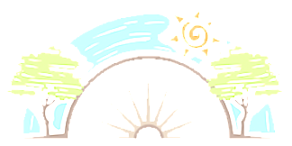

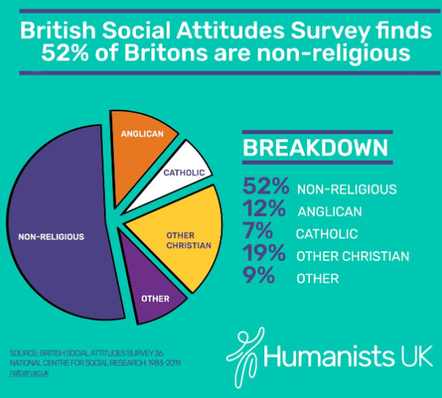
Year 6
To understand religion in the UK
Show an understanding of religion across the UK and what this looks like in everyday life.
RE
Humanism
Humanism is a philosophy or a way of thinking about the world.
Humanism is a set of ethics or ideas about how people should live and act.
People who hold this set of ethics are called humanists.
Humanists prefer critical thinking and evidence over acceptance of dogma or superstition.
Key Vocabulary
Humanism | A set of ethics or ideas about how people should live and act.
Atheism | Does not believe in gods or spiritual beings.
Agnostic | Someone that believes it is impossible to know if god exists or not.
Global events | Something that happens that effects the whole earth/world.
Views | What a person thinks.
How has religion changed in the UK?
Religion has changed over time. This is because of many factors including: full time jobs, weekend work and shifts; men and women working.
Priorities have changed over time. This could be why the number of people who attend church has fallen.
Key questions
Look at the breakdown of religions across the UK. What does this tell us?
Does it show the number of people that are not religious?
Is the picture the same as 100 years ago?
What’s changed? Why do you think that is? Look at the breakdown of religions in Barnsley?
What does this tell us?
Sticky Knowledge
To uunderstand how religion is brought into everyday life especially in today’s society:
To know what it means to be religious and non-religious.
To understand the terms atheist, agnostic, spiritual and humanism

