Slide 1

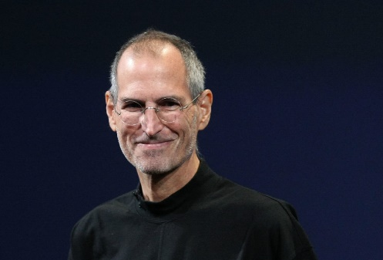
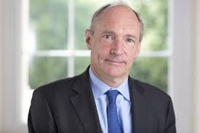
Year 6
Inventors and Inventions
DT
Technology
Steve Jobs
Steve Jobs was born in America in 1955.
He created one of the most famous technology companies in the world, Apple.
In 1976, Jobs met up with his friend, Steve Wozniak, who had invented a special type of computer and they started up a company. Steve’s friend focused on the electronics while Steve began working on the computer’s design.
Over the next few years, they sold many computers and became a well-known brand selling smartphones and tablets.
Tim Berners-Lee
Tim Berners-Lee was born in England in 1955.
Berners-Lee worked at a science laboratory in Switzerland. He wanted to find a way that the scientists could share their experiments with each other. He used the Internet and a special computer language called hypertext to make a way for people at the lab to be able to put information on the Internet. He called it ‘Enquire’. This was a first version of the world wide web.
A few years later, Berners-Lee worked on a form of Enquire that anyone around the world could use. Tim called this the world wide web.
On 6th August 1991, he launched the first ever website (http://info.cern.ch).

Slide 2
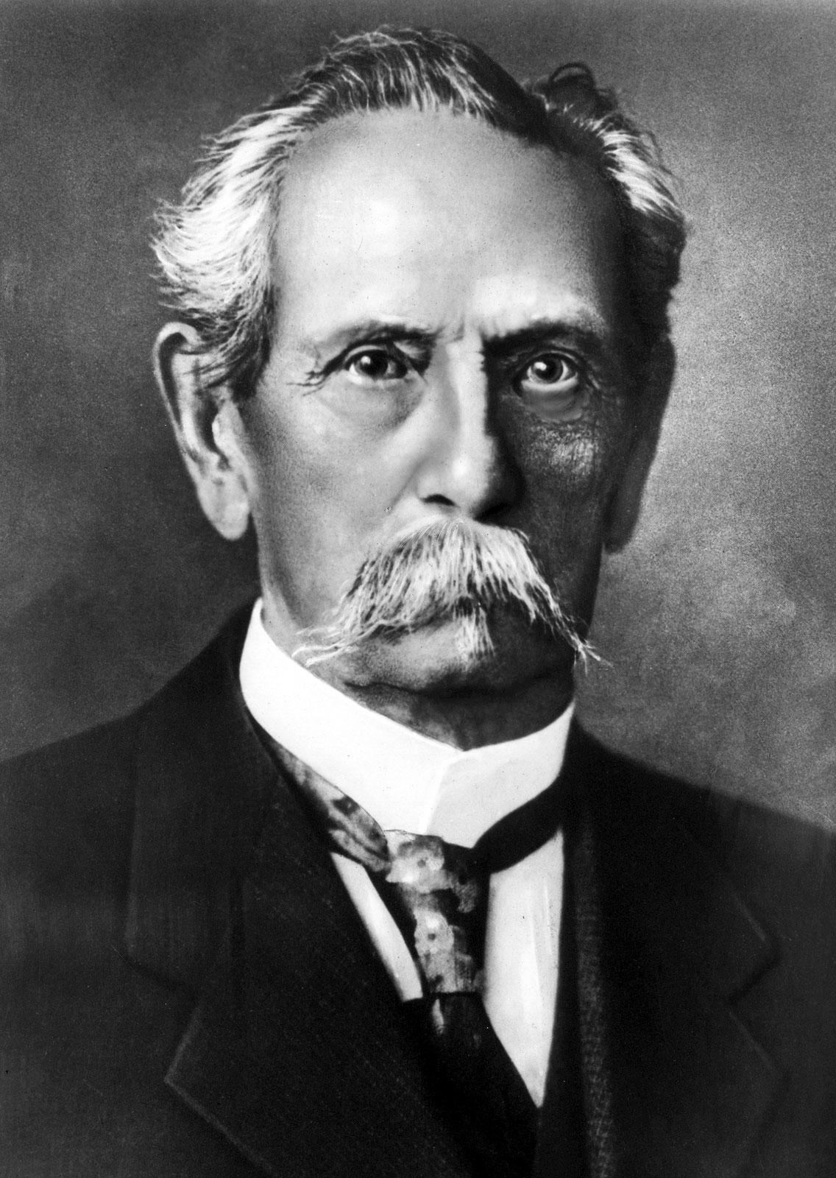
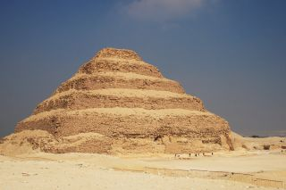
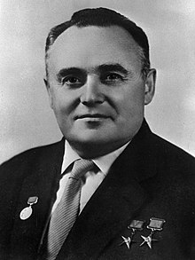
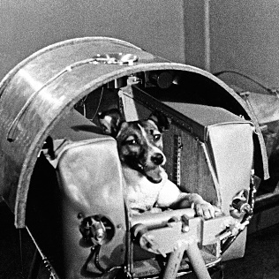
Year 6
Inventors and Inventions
DT
Imhotep
Imhotep was the High Priest of Ra, the sun-god. He became famous for his great wisdom and knowledge. The Egyptians later worshipped Imhotep as a god.
Imhotep was the architect of ‘The Step Pyramid’.
It was built in 2630 B.C. and is the earliest pyramid that is still there today.
Karl Benz
Karl Benz was born in Germany in 1844.
He was an engine designer and car engineer, who is considered as the inventor of the petrol-powered automobile.
He built the world’s first car in 1885 which he called the Benz Patent Motorwagen.
He made the world’s first production car called the Velo in 1894 which also took part in the world’s first car race in France.
He was the founder of Mercedes Benz.
Sergei Korolev
Sergei Korolev was born in Ukraine in 1907.
He was a Russian rocket engineer and spacecraft designer during the Space Race between the United States and the Soviet Union (now known as Russia) in the 1950s and 1960s.
He was involved in the development of the R-7 Rocket and Sputnik 1. He was also involved in launching Laika, the first animal to orbit the Earth, and the first human being, Yuri Gagarin, into space.

