Slide 1
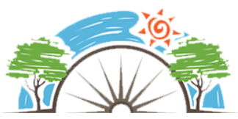
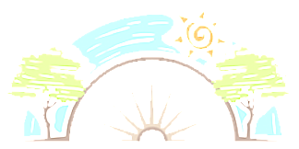


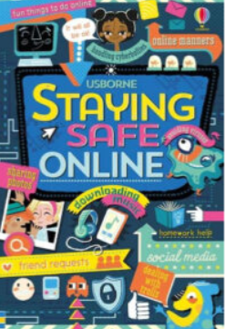




Year 6
Relationships
PD
Sticky Knowledge
I can use negotiation and compromise to resolve disputes and conflict.
I know it can sometimes be hard to say sorry or forgive someone but can affect our wellbeing if we hold a grudge.
I can critique media and identify stereotypes in the world around them.
I know that unconscious bias exists.
I can explore the history of prejudice.
I can think about what understand that they should do if they experience prejudice
I know no-one should be excluded from having friends if you witness bullying or are being bullied, tell an adult you trust or call child line on 08001111.
I can identify the reasons why some children bully.
I can explain the shared responsibility if someone is put under pressure to do something harmful or dangerous and something goes wrong
To learn about the importance of keeping personal boundaries, privacy and consent. (Sharing images).
Key Questions
How can you fix a friendship when things have gone wrong? What does the law say about prejudice? What should we do to defeat discrimination? What makes people unkind? What ‘exit strategies’ can get someone out of a risky situation without losing face? What could be the positive and negative outcomes of sharing images online?
Key Vocabulary
Disputes, conflict, negotiation, compromise, stereotypes, discrimination, bullying, aggressive behaviour, dares, challenges, privacy, sharing, personal boundaries

